Slide 1

OIL PRICE PREDICTION
P310 Group-4
Karthik
15/NOV/23

Slide 2
Business Problem:
Oil is a product that goes completely in a different direction for a single market event as the oil prices are rarely based on real-time data, instead, it is driven by externalities making our attempt to forecast it even more challenging
As the economy will be highly affected by oil prices our model will help to understand the pattern in prices to help the customers and businesses to make smart decisions.
Objective:
The objective of the analysis is to predict the price of the oil and to emphasize the need for a reliable model that can understand price patterns. This model aims to help customers and businesses make smart decisions considering the significant impact of oil prices on the economy.

Slide 3
Project Architecture / Project Flow
Data Collection
Data Preprocessing
Feature Engineering
Train-Test Split
Model Selection
Model Training
Model Evaluation
Prediction
Forecast Visualization
Deployment

Slide 4
Exploratory Data Analysis (EDA) and
Feature Engineering

Slide 5
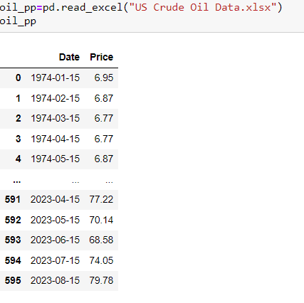
Data set details
Our dataset contains 596 rows and 2 columns, First column describes about the timestamp and second column describes about the Dollars per gallon

Slide 6
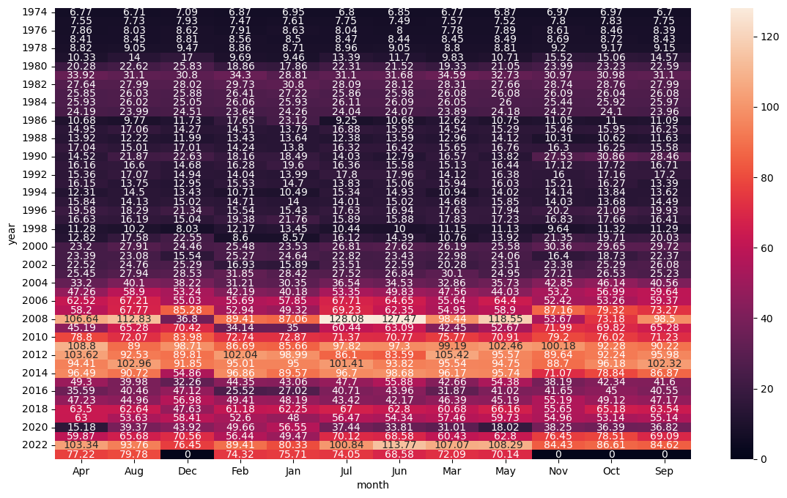
Exploratory Data Analysis (EDA)
Heatmap for analyzing price by their ‘mean’
.We can observe all the values with lighter shades are represents lower mean and the values which are in darker shades are represents higher mean. .As we can observe the prices are started increasing in the year 2008-10

Slide 7
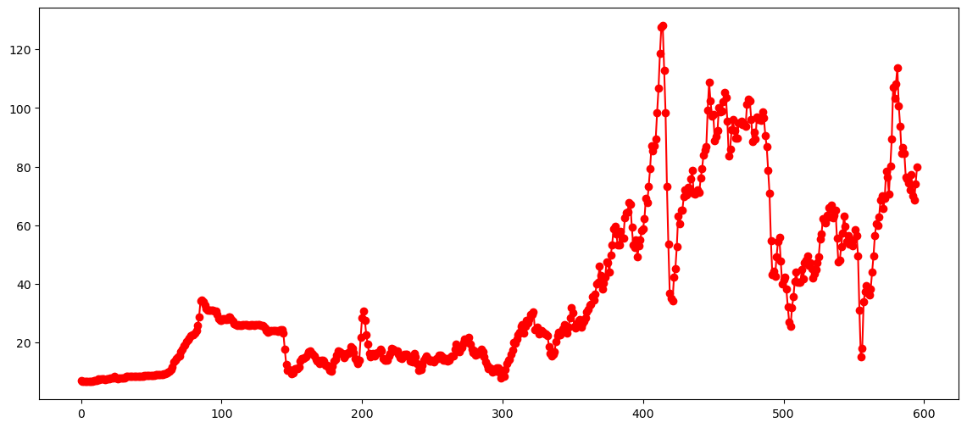
Exploratory Data Analysis (EDA)
.The line plot reveals a notable upward trend in prices during the year 2008, standing out in comparison to other years.

Slide 8
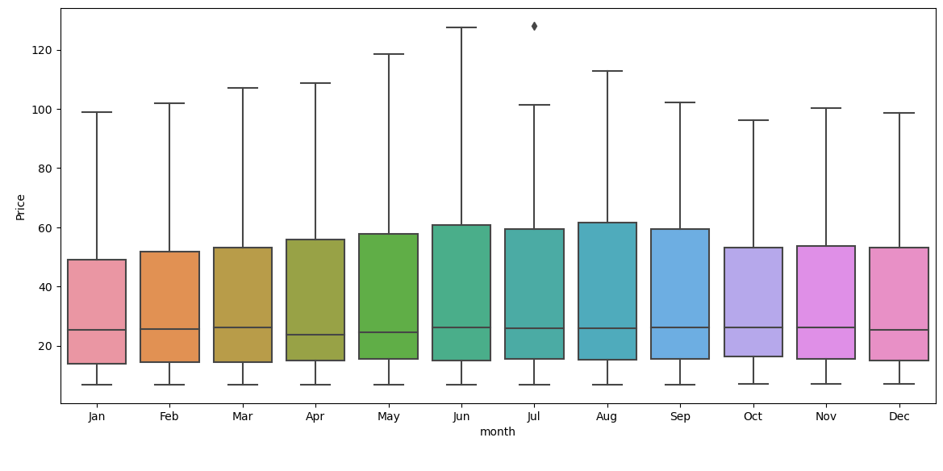
EDA
Monthly Boxplot
.If we observe the price, we found it higher in july and lesser in the months of Dec,Jan and Feb.

Slide 9
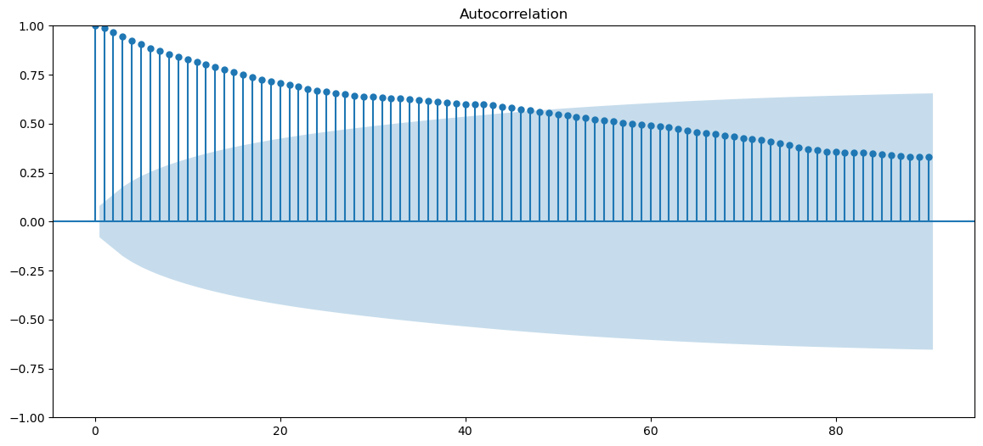
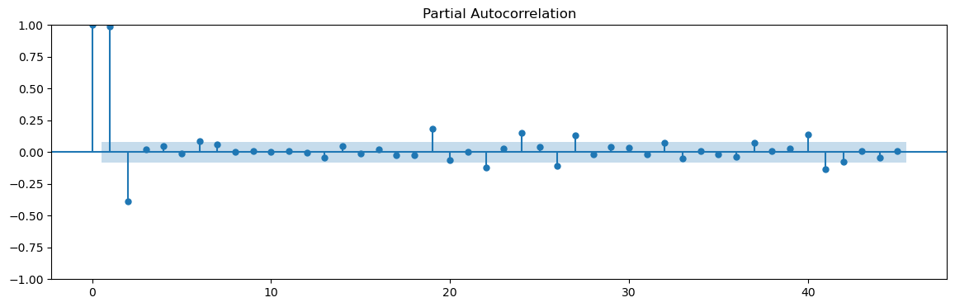
Exploratory Data Analysis (EDA)
ACF & PACF PLOTS
We can observe that ACF plot is having a gradual decrease with its consecutive lagged versions and PACF plot is having sharp cutoff after its second lagged version
We can hence conclude that a Moving Average Model will help giving better results

Slide 10
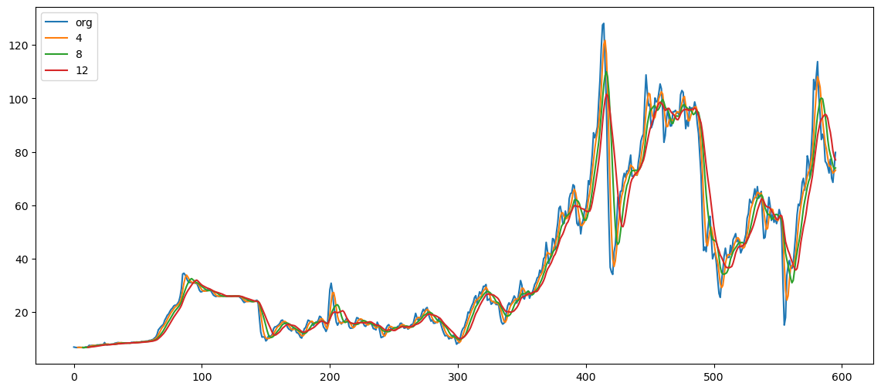
Exploratory Data Analysis (EDA)
ROLLING STATS - MOVING AVERAGES
We are using moving averages to smoothen the time series and here we have moving average at window of 4,8 and 10 with the original curve

Slide 11
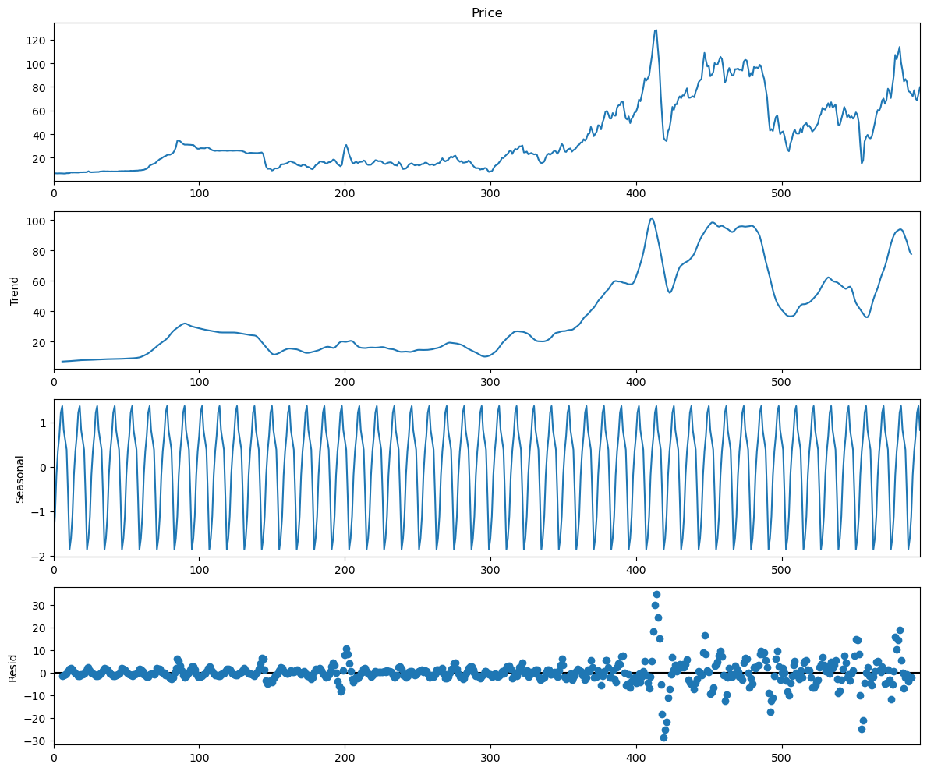
Exploratory Data Analysis (EDA)
Moving average residual has more fluctuations and in trend it follows almost same but suddenly got upsurge.
So, the trends are not constant.

Slide 12

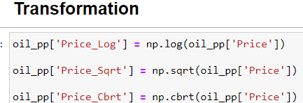
FEATURE ENGINEERING
After performing ADF test result, the time series data turned out to be non-stationary, which implies that either there is no constant mean or variance
So we have used some techniques to convert to stationary time series
Transformations
Differencing

Slide 13
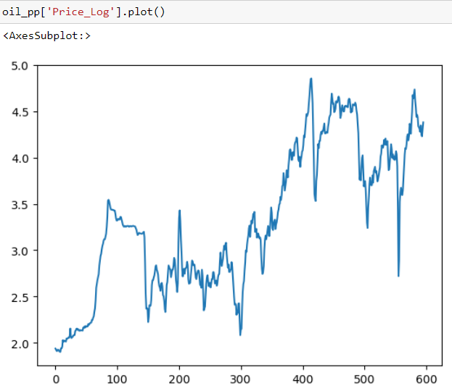
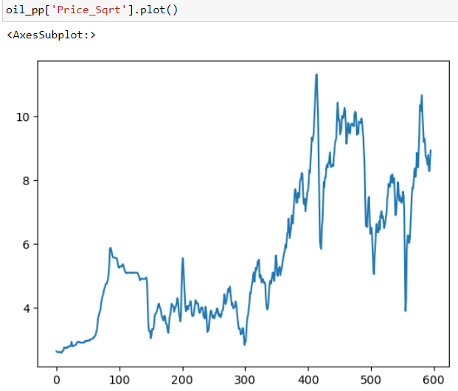
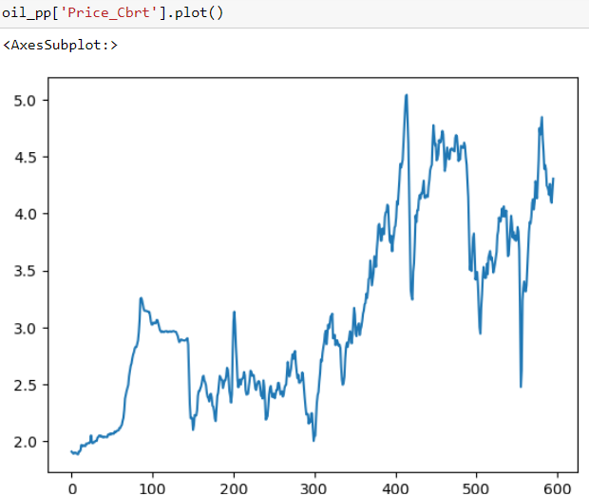
FEATURE ENGINEERING
Transformations
After applying various transformations like Log, Square root, Cube root, the p-values did not give desired results. Hence we are going for other technique Differencing

Slide 14
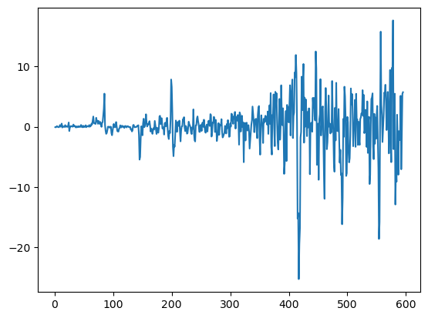
Differencing
.From the ACF test we can say that the time series is likely stationary,which is an essential requirement for many time series analysis and modeling techniques,

Slide 15
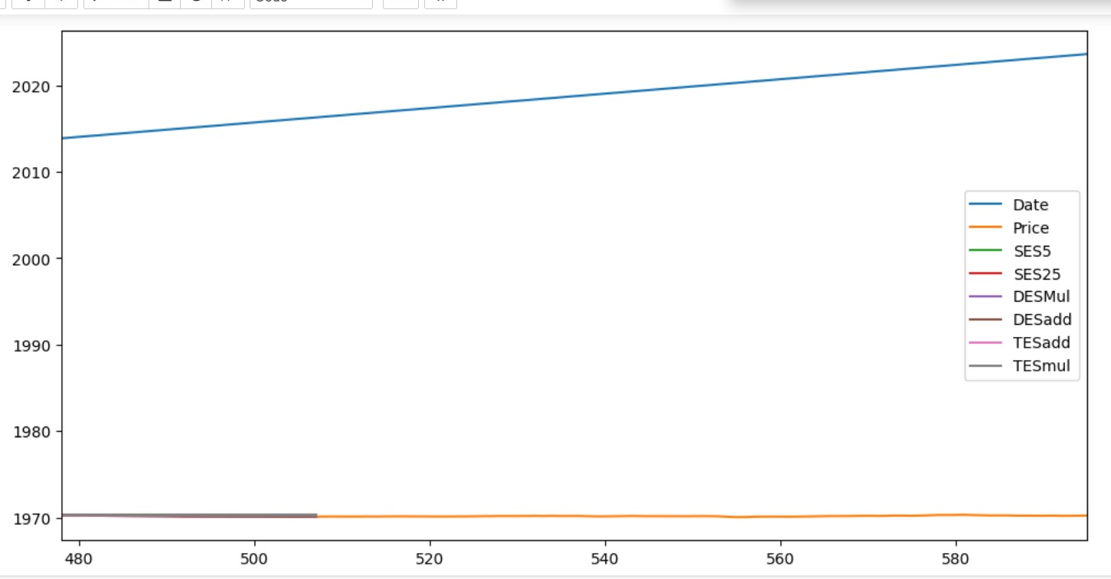
Template for Model results presentation
Model - Holts winter

Slide 16
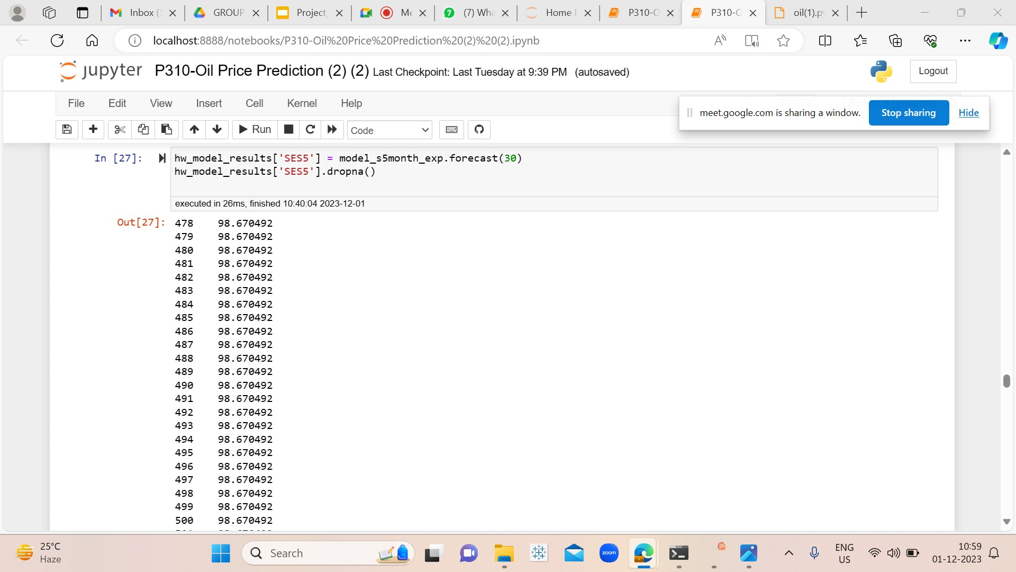

Slide 17
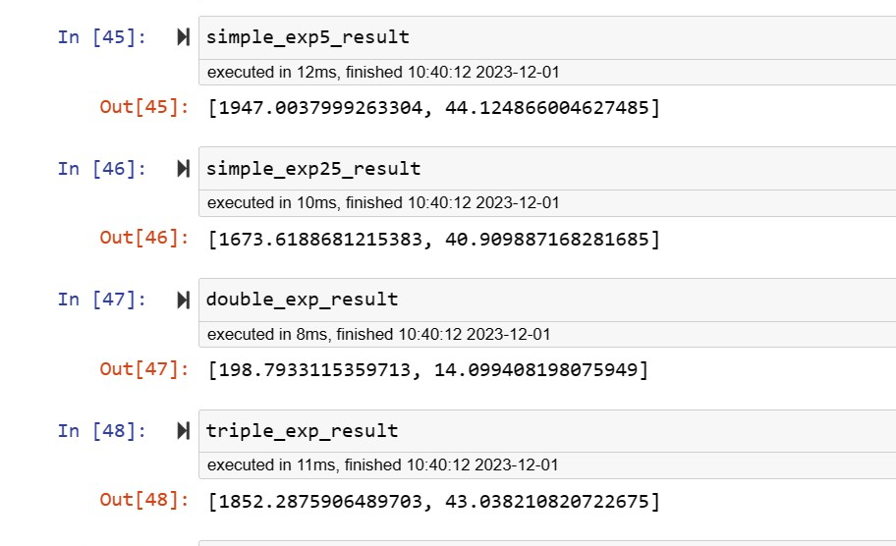
Results :

Slide 18
Model Building

Slide 19
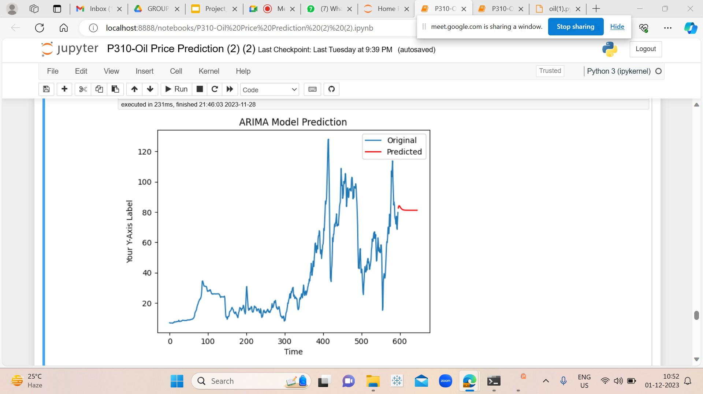
Model Predictions

Slide 20
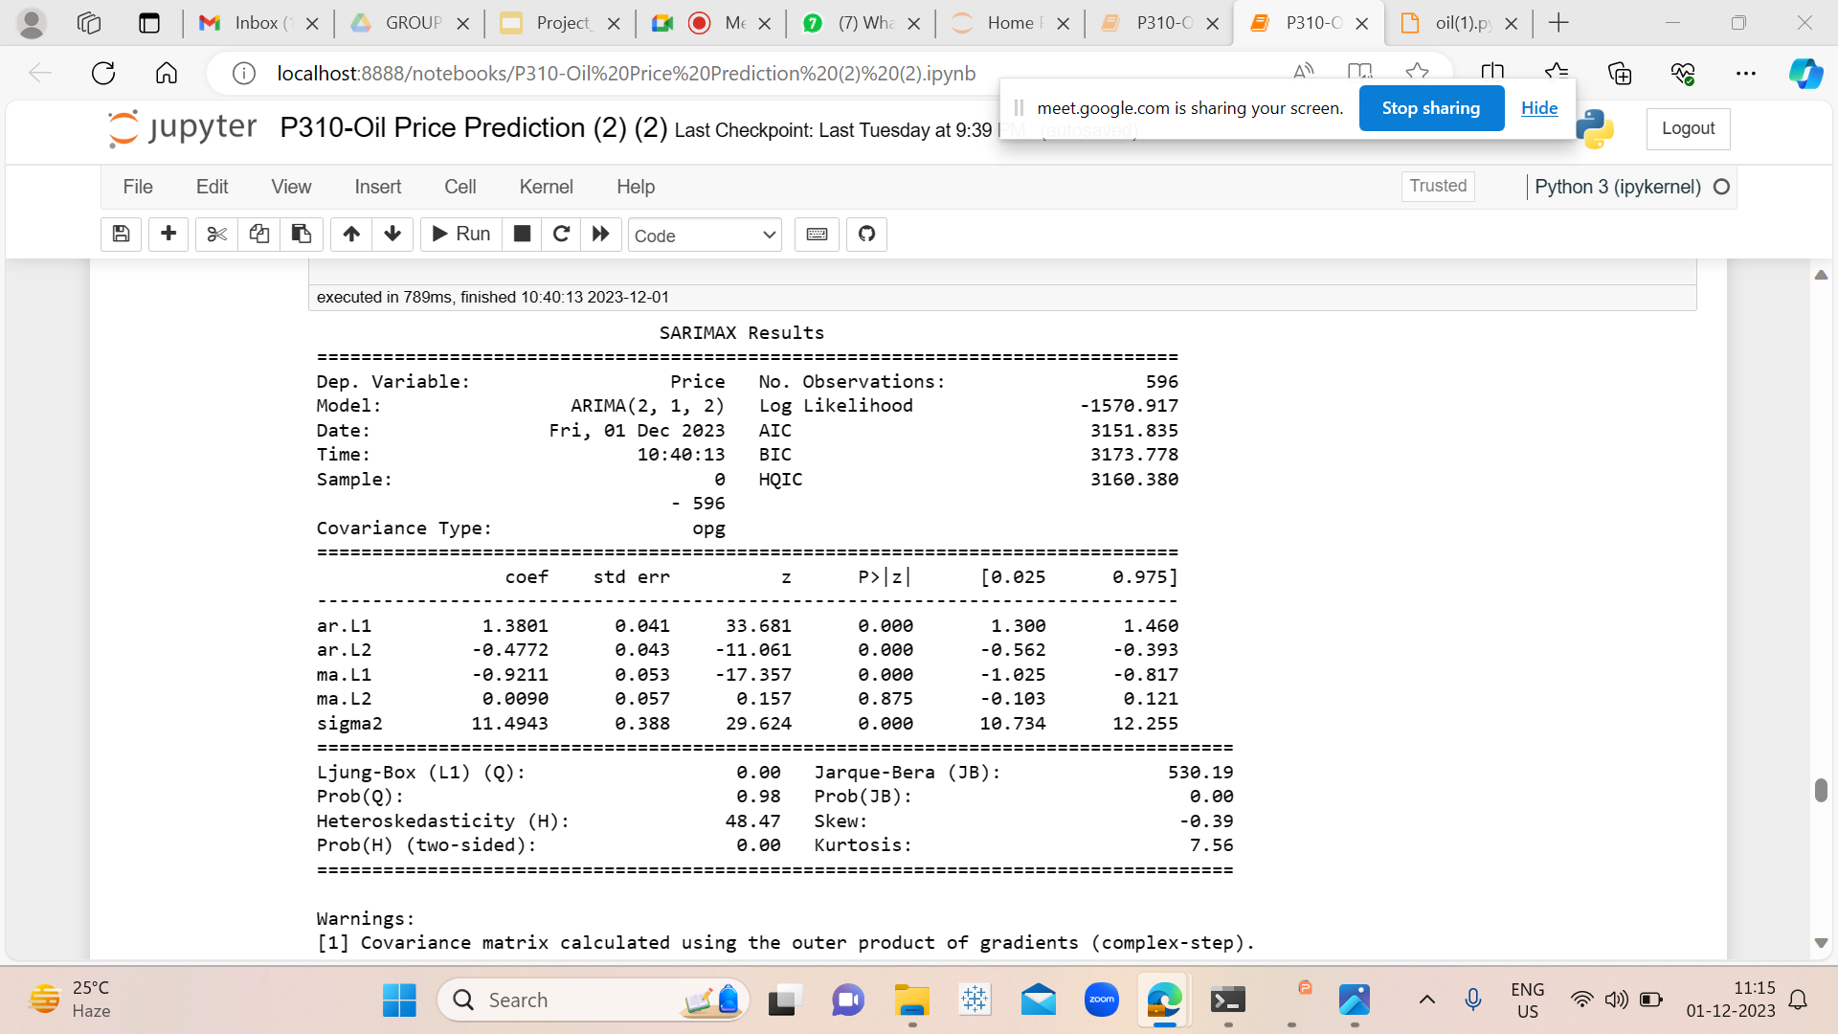
Model Results

Slide 21
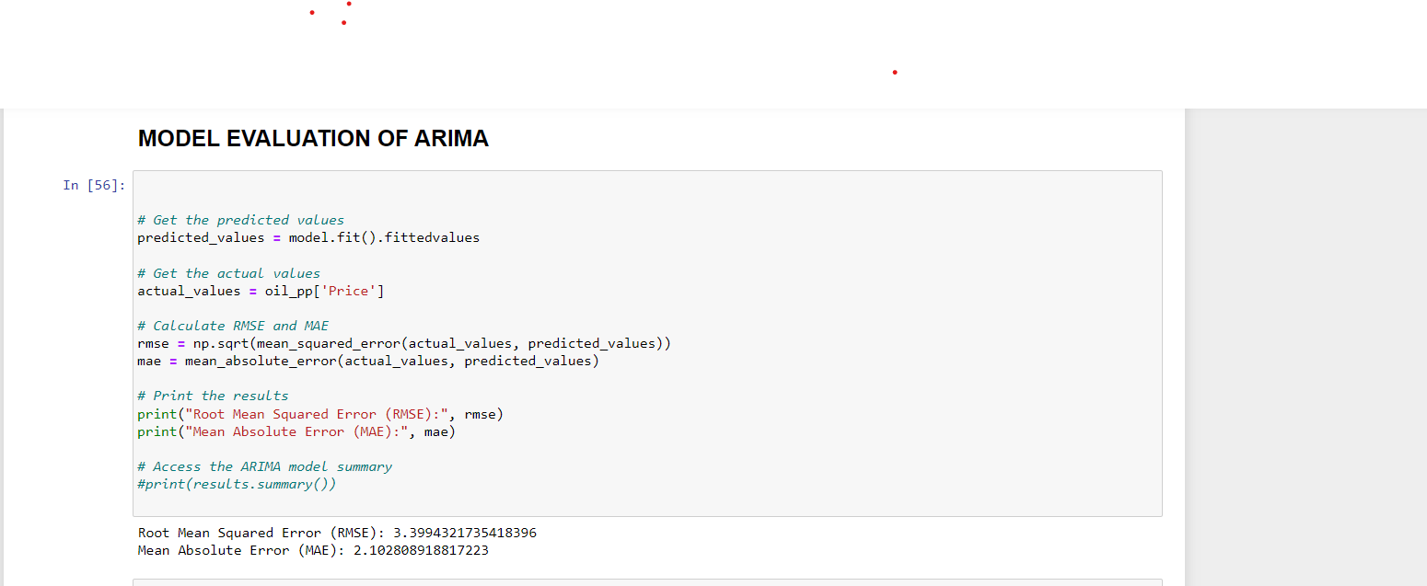

Slide 22
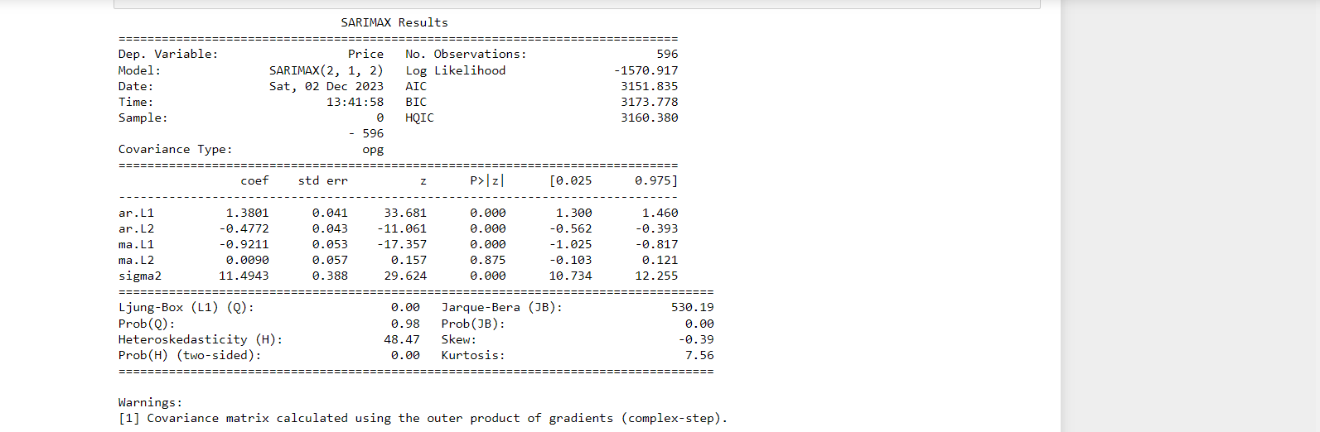

Slide 23
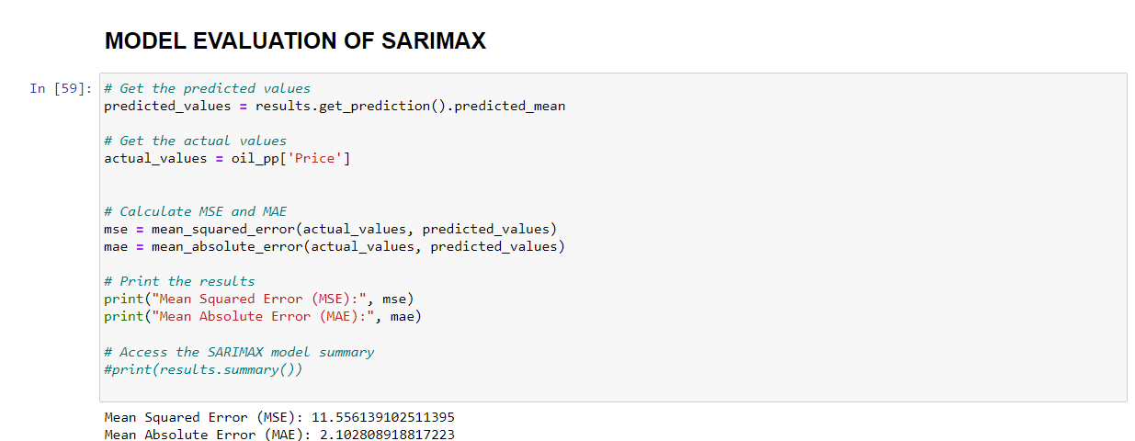

Slide 24
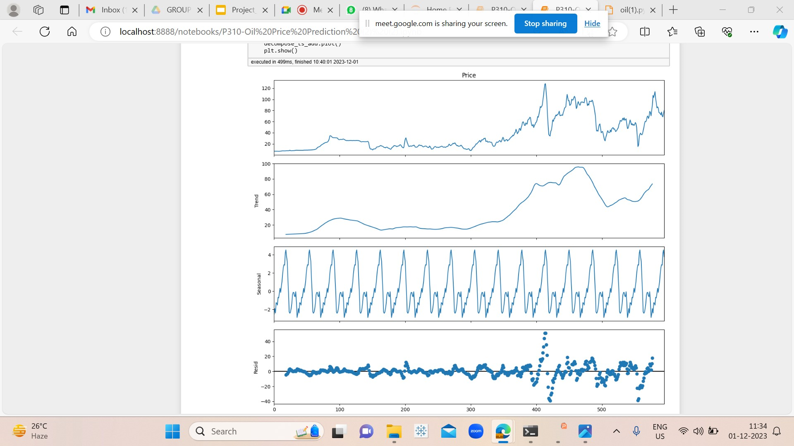
Additive seasonality

Slide 25
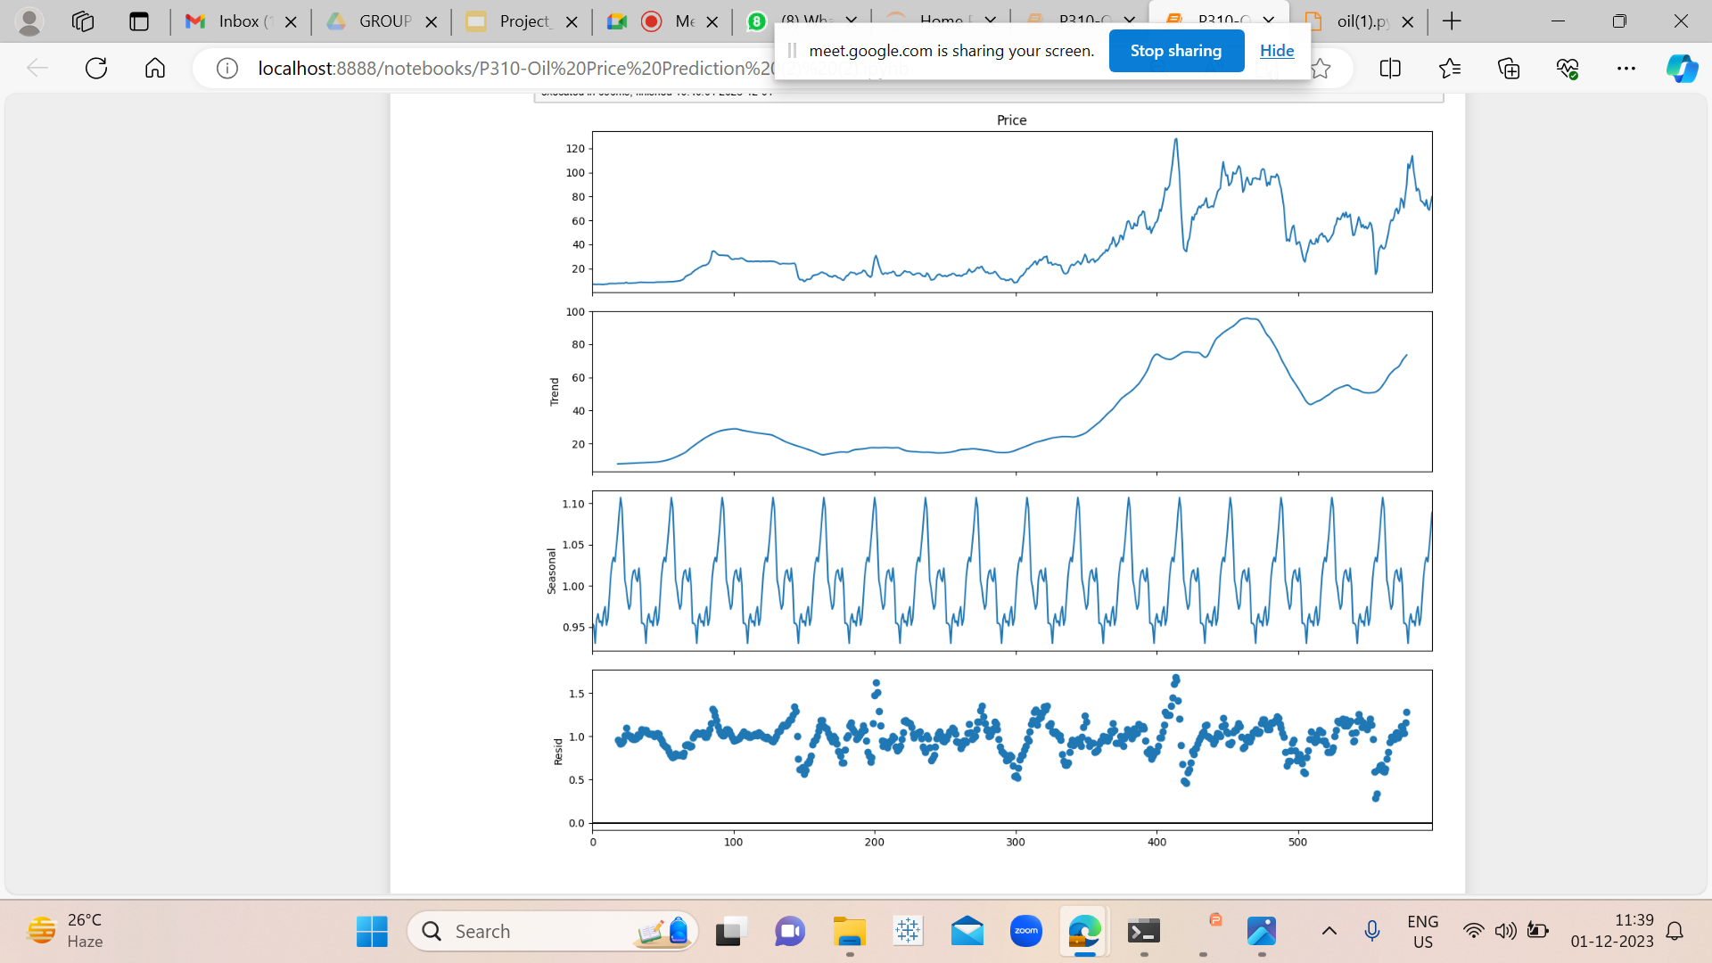
Multiplicative seasonality

Slide 26
Model Deployment:
.Using Streamlit we did the deployment model by using ARIMA model.

Slide 27
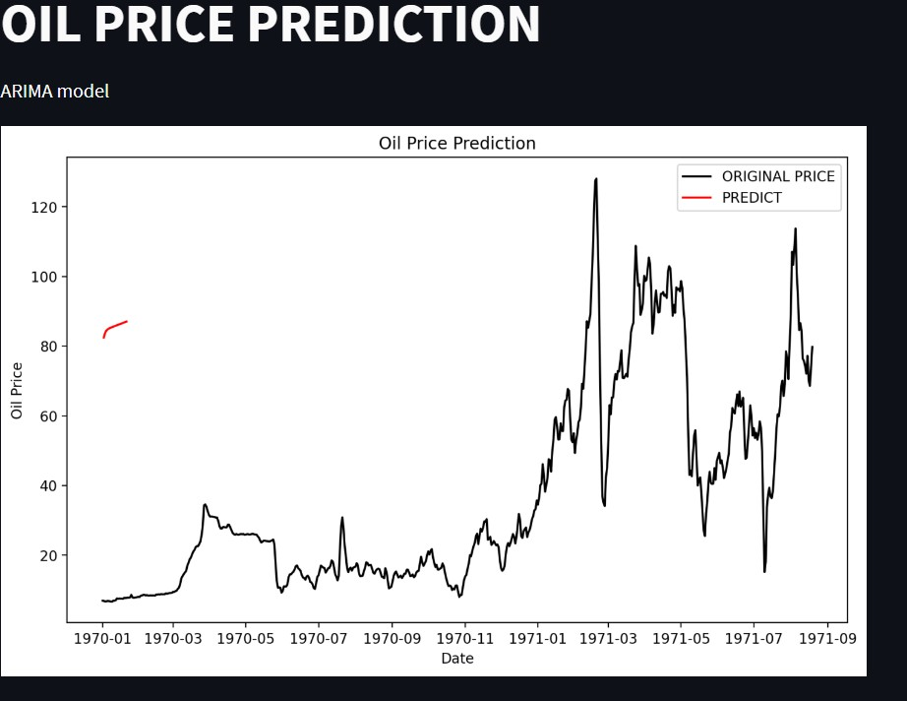

Slide 28
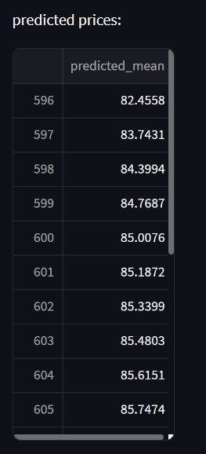

Slide 29
Challenges faced?
.Overfitting and Underfitting the model.
.Selection of suitable method for model building.
.Model evaluation to check the error
How did you overcome?
.Using train-test-split of 70% training and 30% of testing.
.Using 3 - 4 models for selecting the good method which shows
minimum RMSE values.
.Feature Engineering techniques to evaluate the model.

Slide 30
Thank you

